Slide 1
Case study: How were David Bearman’s ideas implemented in the 1990s?
A government recordkeeping regulator’s view
David Roberts
Reinventing Archival Methods workshop
29-30 November 2012

Slide 2
What was happening?
Bearman’s writings, incl.
Archival Methods (1989)
An Indefensible Bastion... (1991)
Record-Keeping Systems (1993)
Archival Data Management... (1993)
Reinventing Archives for Electronic Records... (1994)
Electronic Evidence: Strategies... (1994)
Archival Strategies (1994)
Managing Records Sent by Electronic Mail (1994)

Slide 3
What else was happening?
Recordkeeping Functional Requirements Project (1993-1996)
‘Pittsburgh Project’
Range of products and papers
Much groundbreaking work published by others
Understanding Recordkeeping Systems workshop, Monash University (July 1993)
Australian Standard on Records Management:
AS 4390 (1996)
Developed 1992-1995
Led to international standards

Slide 4
So what else was happening?
New State records legislation
Developed from 1989
State Records Act 1998
Coherent regime for records & archives management across NSW public sector
Provisions included
  Records management
  Digital records
  Distributed custody
Framework of standards, guidelines, tools & training
  Developed from 1995
Other reforms & changes in how State Records functioned

Slide 5
Implementing David Bearman’s ideas
Methodology for designing and implementing recordkeeping systems

Slide 6
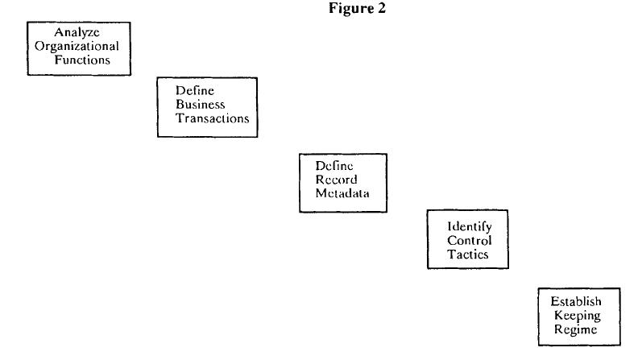
David Bearman and Margaret Hedstrom, ‘Reinventing Archives for Electronic Records: Alternative Service Delivery Options’, in Electronic Records Management Program Strategies, Archives and Museum Informatics, 1993, p97

Slide 7
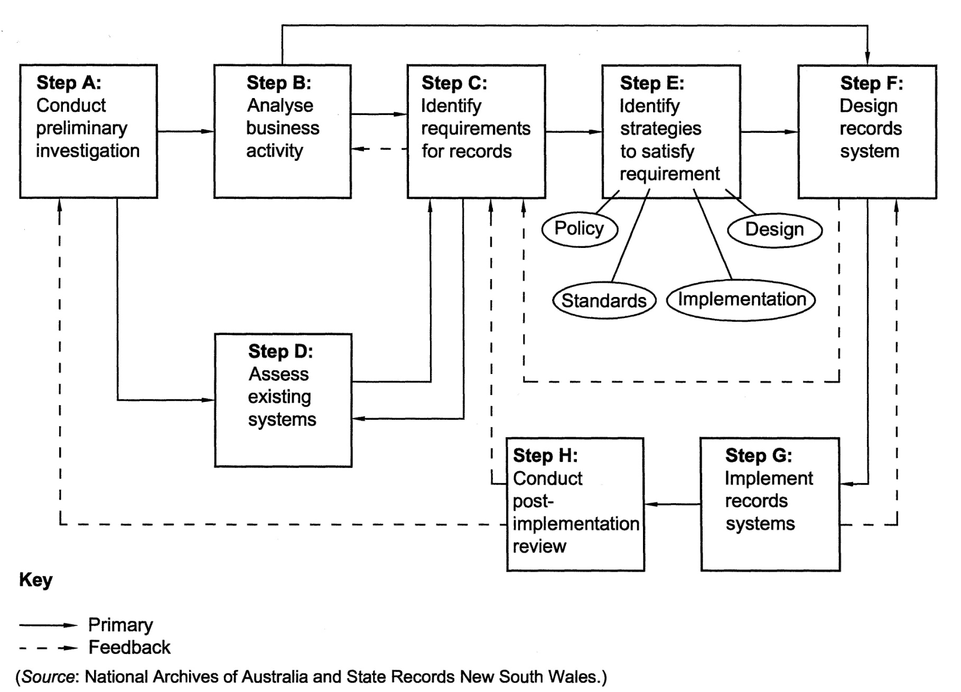
Figure 1 – Design and Implementation of Records Systems (DIRS), in AS ISO 15489.2-2002, Australian Standard: Records Management, Part 2: Guidelines, p3

Slide 8
Implementing David Bearman’s ideas
Methodology for designing and implementing recordkeeping systems
Functional requirements for recordkeeping
Custody and non-custodial models
Strategies for digital recordkeeping and digital archives
Transactions and records
Appraisal and disposal
Arrangement and description

