Slide 1

Healthy Hothouses: Challenges and Opportunities for Recordkeeping Metadata Education and Research
Presented by Joanne Evans
Centre for Organisational and Social Informatics (COSI)
Reinventing Archival Methods
Recordkeeping Roundtable Workshop
29-30 November 2012
Octopod by Syntopia

Slide 2





Clever Recordkeeping Metadata Project
ARC Linkage Project mid 2003-2006
Chief Investigator: Professor Sue McKemmish, Monash University
Partner Investigators: Professor Anne Gilliland, UCLA, and Adrian Cunningham, National Archives of Australia
Industry Partners
National Archives of Australia
State Records Authority of New South Wales
Australia Society of Archivists, Committee on Descriptive Standards
Project Links
InterPARES2 - the MADRAS Metadata Registry
ISO 23081 and IT21/7 – Recordkeeping Metadata Standards
NAA Redevelopment of Commonwealth Recordkeeping Metadata Standard
http://www.infotech.monash.edu.au/research/groups/rcrg/crkm
Notes:
Many of you know I was the PhD student on the Clever RK Metadata Project
ARC linkage project to explore the ‘create once, use many times concept’ – how in integrated systems environment might facilitate the automated capture and re-use of recordkeeping metadata.
Linkage project – featured a collaboration between researchers at Monash, and Industry partners – NAA, SRNSW and the ASA CDS
Project links – connected up with other initiatives happening at the same time.
Great project (well I would say that as it gave me the chance to do my PhD!). Good exemplar of a recordkeeping research project – academic and practitioner researchers in the research team; looking for practical rather than just publication outcomes; Active in collaborating with other initiatives.

Slide 3
Implementing Recordkeeping Metadata
Records Management Application
Schema
Web Management Systems
Web Management System
Crosswalk
Archival Gateways
Schema
Archival Gateways
Email
Email and Desktop Applications
Records Management Application
Archival
Management Application
Subject Portals
Desktop Applications
Metadata
Broker
Subject Portals
Schema
Schema
Crosswalk
Schema
Crosswalk
Schema
Community Archives
Business Systems
Community Archives
Schema
Crosswalk
Business Information Systems
Archival Management Application
Metadata
Broker
Notes:
What we did was look into designing and building a metadata broker to transform from having to hardwire systems together or relying on manual RK metadata re-creation to move it from business system to records management system to archival control and beyond.
[CLICK] Metadata Broker – repository of the metadata schemas in the various systems, And of the crosswalks between them. Way of managing and documenting compliance with rk metadata standards
[CLICK] Then if instead of hardwiring we start to use the Metadata Broker to automate the translation of metadata between systems end up with an architecture that opens up a whole lot of other possibilities. RK metadata from RM systems being deployed into business systems; RK Metadata from archival control systems being deployed into records management environments; Sharing of RK metadata in archival control systems into distributed, multi-provenance discovery frameworks
Continuing the incremental evolution of this infrastructure for interoperability …

Slide 4
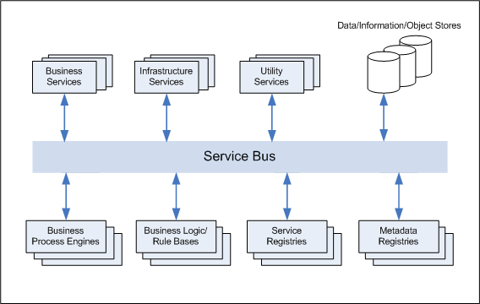
Innovate to service oriented future
Recordkeeping Services
Notes:
Can innovate to a service oriented future, in which we have recordkeeping services available for deployment into business processes and systems, and themselves configured in such a way – dynamic, responsive to business and rk business change, scalable and sustainable

Slide 5
CRKM PROJECT Outcomes
Identified the potential in emerging service oriented architectures to deliver IT environments based on interoperability
  Embed recordkeeping processes into business processes
  Inherit recordkeeping metadata from process environment rather than manually re-create
Barriers to interoperability in our existing recordkeeping processes, standards and tools
  Recordkeeping practices and tools still dominated by paper paradigm and paper thinking
  Tools manage records rather than managing recordkeeping
Notes:
What the CRKM Project found in exploring such a vision
Great Potential
But significant barriers in our own recordkeeping processes, standards and tools

Slide 6
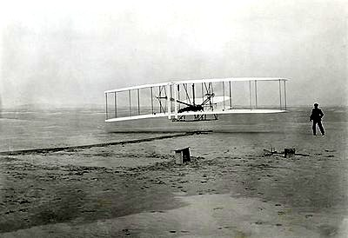
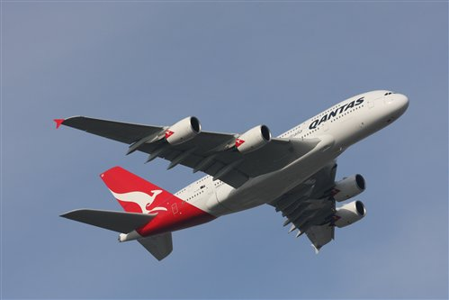
The Metadata Challenge
Image:FlyPHANUK
Image: Wright Brothers Collection, Special Collections, Wright State University
Notes:
Presented these outcomes in terms of an aviation metaphor

Slide 7
From ................... ToWARDS ................
Paper paradigms
Paper standards
Automated paper systems
Unsustainable, unscalable, expensive and resource intensive manual metadata creation and use processes
Stand alone systems or systems hardwired to interoperate
Metadata standards and schemas that do not support interoperability
Digital paradigms
Digital standards
Digital recordkeeping processes and systems
Sustainable, scalable, automated, metadata creation, gathering, sharing and re-use processes
Integrated systems and federated digital repositories
Metadata interoperability
Interconnectivity
Notes:
Make no mistake we have come a long way – but still a long way to go
And by the end of the project many of us were a little metadata-ed out.
So today’s workshop is an excellent opportunity to ask
[CLICK] When it comes to recordkeeping metadata, in general, and interoperability, in particular, how are we doing?

Slide 8
Records - recorded information, in any form … created or received and maintained by an organization or person in the transaction of business or the conduct of affairs and kept as evidence of such activity
AS 4390.1-1996
Records = Recorded Information +
Recordkeeping Metadata
Recordkeeping Metadata - standardised information that identifies, authenticates, describes, manages and makes accessible through time and space documents created in the context of social and business activity.
SPIRT Glossary 2000
Notes:
Why does it matter? Many roll their eyes at the ‘m’ word or think it only applies to digital stuff, to current records management, something they are just not interested in.
This is a big problem as recordkeeping metadata is fundamental
Not records and then worry about the recordkeeping metadata
[CLICK] Don’t have records without recordkeeping metadata, whether implicit, explicit, intrinsic or extrinsic.
Recordkeeping metadata refers to the layers of ‘structured data about data’ which tie recorded information objects to the contexts in which they are created, managed and used, so that they may function as authentic and reliable evidence of those activities.
This metadata also allows for records to be discoverable, accessible and interpretable through time and space, formulating and structuring our memory management frameworks.
Records are, and have always been, networked information objects. Perhaps now have the technology, and the opportunity, to exploit this in ways never before envisioned to create better recordkeeping systems

Slide 9
Progress Report
Conceptual Models for
Recordkeeping Metadata
Recordkeeping Metadata
Standards and Schemas
Barriers to Interoperability
Progressing the Reinvention
Notes:
Confess to being a little metadata-ed out by the end of the noughties

Slide 10
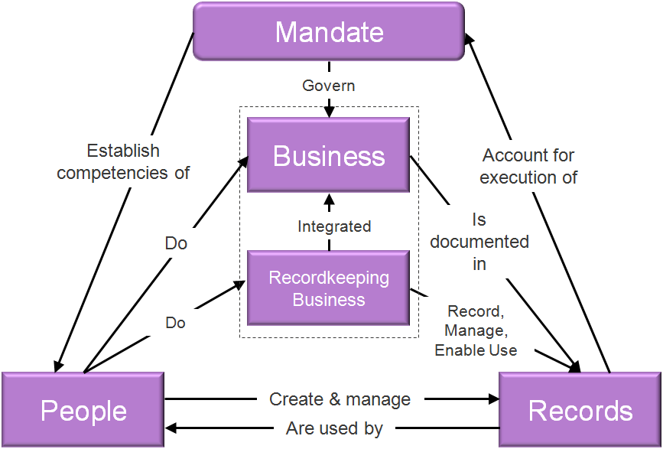
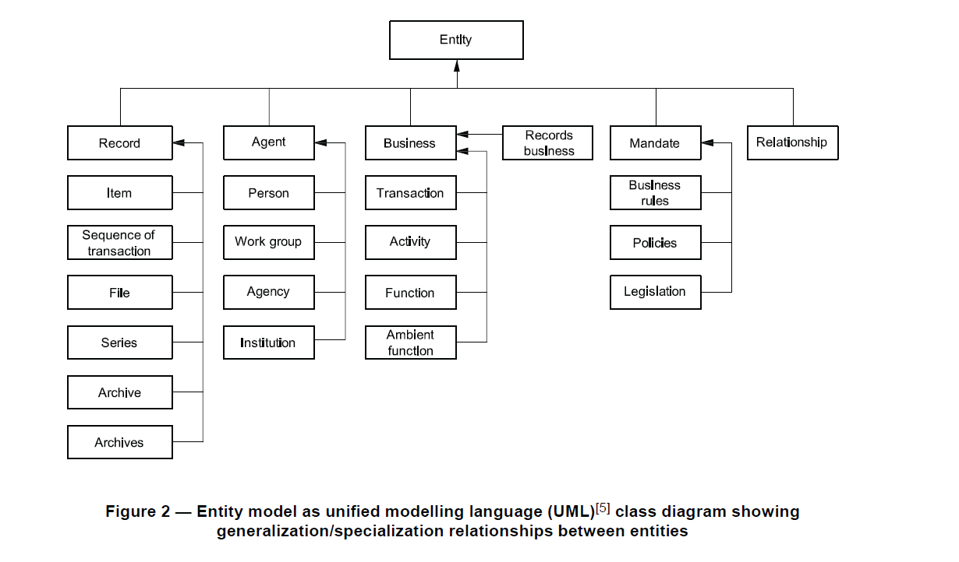
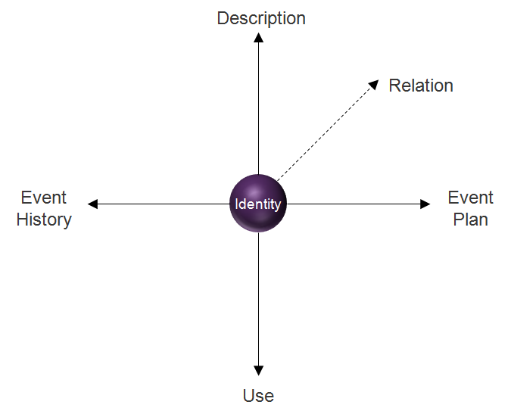
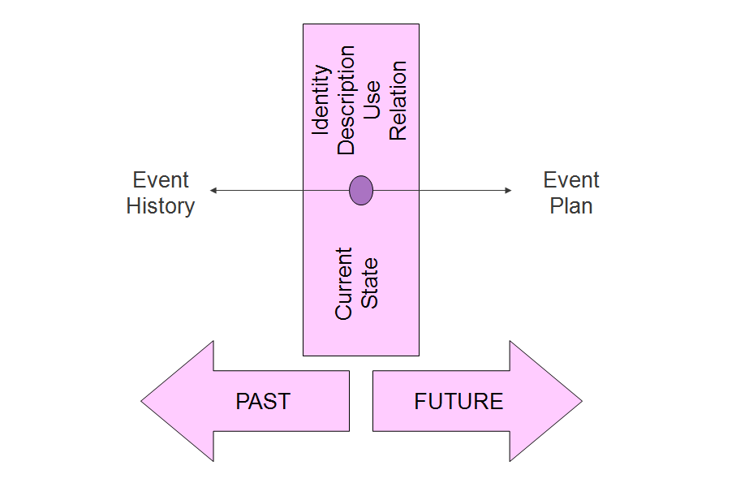
RecordKeeping Metadata Models, Standards and SchEmas
VERS
Metadata
Schema
SARKMS
NSW
RKMS
AGRKMS
RKM Standard Schemas
Application Profiles
ISO 23081
Notes:
This has been the driver for the development of a number of Recordkeeping Metadata Models, Standards and Schemas
We have ISO 23081 – Aspirational standard for recordkeeping metadata interoperability
Brings together a number of models to make sense of recordkeeping metadata
Why so many? Dealing with complexity – RK metadata is the most complicated of metadatas. Dumbed down, simplistic solutions not sufficient.
Problem is that when it comes to record’s authenticity, integrity, accuracy and reliability need quality metadata – authentic, accurate, reliable because it too is a record.
Haven’t yet got the frameworks to work out in any recordkeeping situation what rk metadata is adequate or good enough
We have a number of jurisdictional RKM Schemas
Developed in conjunction with the ISO 23081
Others in this session to give update on where at with them
Idea is that these now get applied as application profiles, and because they are based on the jurisdictional standards, in term based on ISO 23081 – we have interoperability
If only it was that easy!

Slide 11
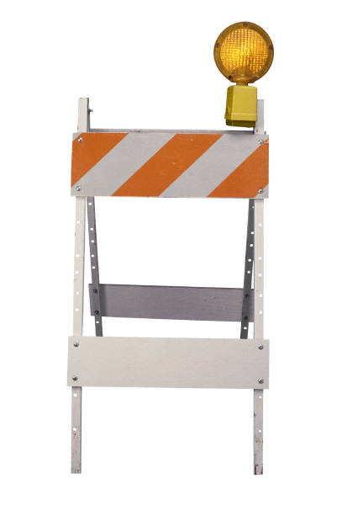
Barriers to interoperability
Standards compliance does not guarantee interoperability
Automated paper recordkeeping tools
Develop infrastructures for interoperability
Focus more on machine rather than human readability
Focus on behaviour now have better understanding of structure
Apply findings on recordkeeping metadata to our own tools and systems
Notes:
There are some significant barriers to interoperability in our thinking and our doing.
[CLICK] Firstly – Standard schema compliance does not equate with interoperability.
In the Clever Recordkeeping Metadata Project, our investigation of services oriented architectures gave us an appreciation of the extent of infrastructures for interoperability.
Developing a standard schema or application profile is just a beginning not an end. One small piece of the puzzle
What we have done so far still too abstract – got to do more doing and thinking on machine rather than human processable representations, and on behavior rather than just structure of recordkeeping metadata
[CLICK] Secondly limited Recordkeeping Metadata interoperability in automated paper tools
Where we have to start in developing infrastructures for interoperability and in moving to machine processability is to look at our own tools
How well do the recordkeeping instruments we produce and champion represent recordkeeping metadata for machine interoperability?

Slide 12
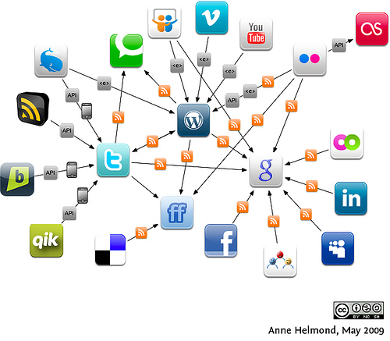
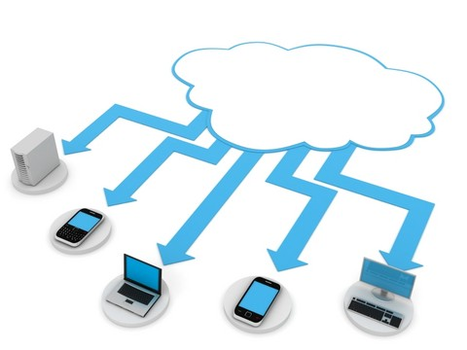

Interoperability Imperatives
Recordkeeping Services
Notes:
Imperatives for Interoperability – increased since the CRKM Project
Service oriented architectures
Social media => social business
Cloud computing, Software as a Service (SaaS
Mobile Devices – if we are not thinking about how to get recordkeeping interfaces onto these then we are in big trouble.

Slide 13


What can we learn from those currently successfully automating metadata capture and/or facilitating its augmentation?
Automate capture of transactions
Filing as sharing/tagging embedded in social processes
Derive useful metadata by mining content and context
Notes:
So what to do to move forward and progress the recordkeeping metadata interoperability revolution
What can we learn from those currently successfully automating metadata capture and/or facilitating its augmentation?
[CLICK] Turn to a couple of internet and Social Media giants for some ideas
Firstly Google – king of deriving metadata about web pages through mining content and context to use in their search and page rank algorithms
Anyone looked at Google Analytics? Staggering the amount of information that can be derived from transaction logs
Got to improve our own capacities to derive metadata in automated ways rather than relying on human input
Facebook
Like Google, automatically capturing billions of social transactions
Millions of people happily sharing and tagging stuff in context – Sounds like what we want to do when we ask people to file stuff?
Adding metadata without complaint – through profiles, tagging, likes/dislikes etc. How can this behaviour be translated into business environments and applications?
What happens if we apply into recordkeeping systems?
Not just a veneer of crowd sourced content – but augmenting what can easily capture automatically about transactions with layers of derived and human supplied context
Sharing and tagging embedded into business processes
I don’t think we can afford not to think about how our standards and practices play out in these kinds of spaces.
Social media will transform the way we go about business – are our recordkeeping instruments going to be able to handle it?
Can the conceptualisations of recordkeeping metadata discussed today help?
From being involved in some of their development I believe that they can
They have been designed with integration into all kinds of systems in mind
They are intended to be aspirational
Perhaps not about top down development of agency or organisation wide schemas, but how might work for localised mapping of recordkeeping functionality between business and recordkeeping control systems

Slide 14
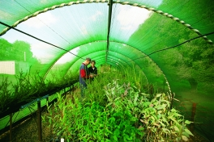
Responding to Re-Invention Challenges
http://www.sustainable.unimelb.edu.au/content/pages/water-food-and-energy
Notes:
How do we respond to these challenges, that would see us reinvent our methods?
Addressing these issues requires a complex mix of research and practical activities, that can take emergent ideas, explore their promise, shepherd their development and foster their realisation and deployment into disciplined enterprise systems.
This suggests the need for researchers and practitioners to be able to come together in ‘healthy hothouses’ that can nurture recordkeeping innovation

Slide 15
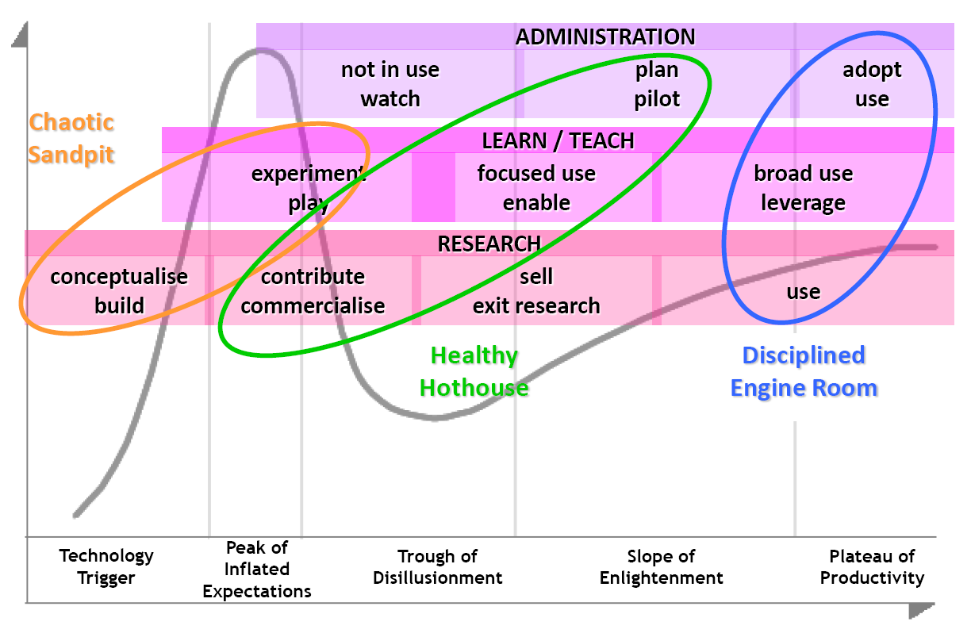
Descent into obsolescence
Taken from Paul Bonnington’s presentation at VERSI eCoffee 6 May 2008
Notes:
Healthy hothouse idea – comes from involvement in eResearch at Melb Uni
Paul Bonnington the Monash eResearch Director presented this diagram at a VERSI eResearch coffee morning in 2008. Nice to hear someone say – ‘Hey there are problems in e-Research, not always getting returns on investments, not getting the expected general uptake’ and here might be why
Gartner hype-cycle, overlaid with 3 zones – Chaotic sandpit, Healthy Hothouse and Disciplined Engine Room
In eResearch have a lot of stuff happening quickly amongst early adopters (researchers and research support), with the administrators then wanting to turn that immediately into enterprise systems.
Bonnington’s point - eResearch space neglecting the Healthy hothouse – where a promising technical innovation gets turned into a disciplined system, study its integration and impact (positive and negative), and supporting infrastructure (technical, organisational and social) develops and matures
As the title of this presentation suggests I’m very taken with this idea
The healthy hothouse is exactly where I want to be with my research – translation of IT and information services into disciplined systems so that the many rather the innovative few can reap the benefits, and that the needs of all stakeholders are taken into account, to build robust, reliable, sustainable, productive, integrated systems
Same with electronic recordkeeping – want to move instantaneously from chaotic sandpit to disciplined engine room – as used to dealing with mature systems => Missing the healthy hothouse where can both promote and explore technological transformation, along with social and organisational dimensions, to develop the enterprise recordkeeping engine rooms of the future
[CLICK] As an aside two annotations to add
Missing a fourth area - Descent into obsolescence - where systems age and decline, may become a barrier to innovation and productivity and where there is a need to rescue the information infrastructure they are responsible for before they die
Research always valid

Slide 16



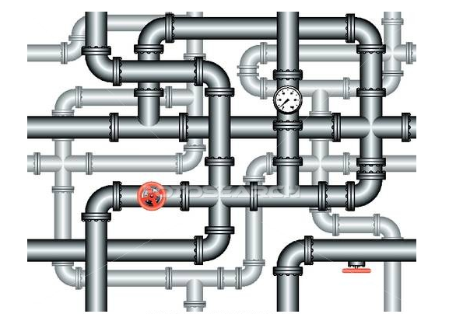
Practice
Concepts
Principles
Praxis
Education and Training
Research
Infrastructure
Notes:
But Research is only one of the elements for the healthy hothouse
For me it’s also about professional education – that to is in need of energising
need a healthy respect for professional qualifications across the profession,
need to commit to Masters qualifications or equivalent as a 1-year GDIKM is not enough,
how also need to get records and recordkeeping concepts in ugrad IT (and other) curriculum

Slide 17
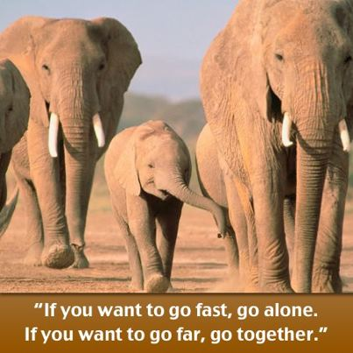
Source: http://www.facebook.com/PoonamKanwarBusiness
Notes:
Al Gore in accepting his Nobel Peace Prize in 2007 referred to this African Proverb

