Slide 1
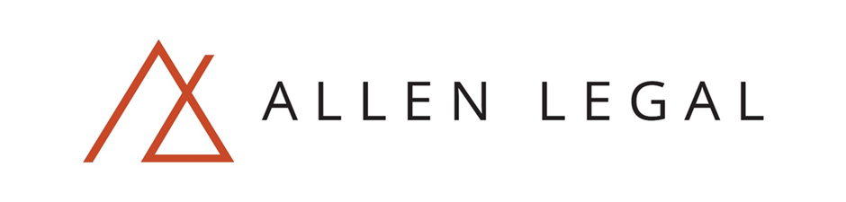
SMART CONTRACTS
A deconstruction
PAYAL K

Slide 2
PREMISE OF DISCUSSION
Premise of discussion – Smart contracts are the way of the future, but need to be sufficiently ‘tweaked’ to reduce the gap between the law as it stands today and smart contract mechanisms.
The idea of today’s discussion is to effectively reverse engineer a smart contract to make it worthy to stand a judicial test.

Slide 3
COMPONENTS OF A TRADITIONAL CONTRACT
OFFER
ACCEPTANCE
CONSIDERATION

Slide 4
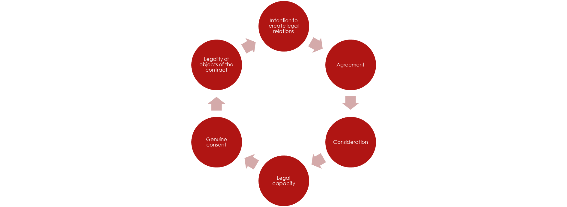
TESTS TO BE SATISFIED

Slide 5
ROLE OF THE JUDICIARY
Why have judicial intervention for contracts?
To remedy mistakes, to adjudicate on issues and disputes and to ensure that contracts entered into are legally binding, and enforceable.

Slide 6
SOME ‘SMART’ FACTS
Smart contracts are immune to various types of fraud, uniquely tamper proof and are even unaffected by court issued injunctions.
Ideally a smart contract will be written, distributed, run and paid out in such a way that there is no single party which can stop a smart contract's operations, because no single party controls a smart contract in any of its critical operations, bilateral control being shared among many parties.

Slide 7
SMART CONTRACTS
If/Then variables
Proof of performance –avoids dispute resolution on the basis of data proving the contractual performance
Any addendums, additional documents can be a part of this
Add a signatory
Provide for pre-payment in escrow
Reliable reputation about fulfilment of future agreements

Slide 8
WHAT CAN GO WRONG?
Mistakes cannot be remedied: mistakes in law, mistakes of fact
Capacity to contract - legal capacity to enter into a contract: minors, mentally ill, intoxicated
Illegal or void contracts?
Undue influence, duress?
What rules can apply, if any? – jurisdiction unclear
Termination of the contract?
Remedies? - how would specific performance, injunctions be dealt with?

Slide 9
Privacy implications (hard to wiretap).
Cross border transactions.
Lack of regulation in a decentralized marketplace where effectively blockchain gets rid of a ‘clearinghouse’.
Decentralised market – with no middleman, no regulation, need for licensed market is reduced. What does this mean for the public at large? -fluctuations in financial instrument prices.
Regulatory aspect – difficult to clamp down on illegal activity – Banks and financial institutions – KYC and anti-money laundering.
No requirement for a clearing house/ middleman and therefore no e-commerce delays.
Ease of use.
Transparency in governance.
From archiving perspective – Proof /evidence of timestamping/ existence – Once entered cannot be undone.
Thomas Friedman’s ‘Lexus and the Olive Tree’ and how this ties in with globalisation.
ISSUES
BENEFITS

Slide 10
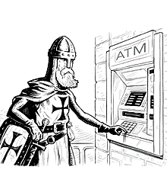
SOMETHING TO THINK ABOUT
Illustration by Lars Leetaru
                Just like ATMs and non branch, ‘online banking’ was a revolution in its own time, so too, blockchain based contracts would mean a paradigm shift in how we operate.

Slide 11
SOMETHING TO THINK ABOUT
“….Blockchain might streamline transaction processing by establishing a single source of truth, available to all, updated in near-real time. This could increase the speed of exchange, reduce the number of intermediaries (and the costs associated with them), improve security, digitize assets, give wider access to people who don’t have bank accounts, enable better bookkeeping, and improve regulatory compliance.”
by John Plansky, Tim O’Donnell and Kimberly Richards

Slide 12
SOMETHING TO THINK ABOUT
To quote Aaron Wright and Primavera De Filippi, (and give credit where credit is due!) it can be seen that
“if we want to preserve the opportunities provided by emerging blockchain technologies – in terms of individual freedoms and emancipation, democratic institutions, and the creative expression – while avoiding or reducing to the minimum the possible drawbacks that they might introduce in society, the time has come to start thinking about a new paradigm of law that could balance the power of blockchain technology and emerging autonomous systems in way that promote economic growth, free speech, democratic institutions and the protection of individual liberties.”

Slide 13
#BLOCKCHAINSNOTBORDERS Estonia And Its Foresight
Use the public notary to sign and permanently record your legal documents on the ​blockchain – a public ledger distributed amongst hundreds of thousands of computers around the world. The process of ‘filing’ the document in the blockchain is called time-stamping – it proves your record existed at a given time, eliminating any possibility of forgery.
Blockchain notarization is an effective way to record marriage contracts, wills, birth certificates, child care contracts, land titles and business deals, among many other records. The security of the blockchain protects the document permanently, ensures its easy access, and proves its authenticity and ownership anytime you need it.

Slide 14
SOME EXAMPLES
Trust-less systems such as electronic voting machine example in India and most recently in the US.
E-Commerce examples – openbazaar.com – Using ‘multisig’ p2p contracts to buy and sell products – no middlemen , but only available in Bitcoin for the moment.
Examples of royalties received in the music industry – or similar examples we can use to add a royalty every time someone has used it and a fee is accordingly calculated.
Where archiving comes into the picture – relativity and ringtail.
Lexus and the Olive Tree – what this means in the context of borderless blockchains.
The tipping point: Tax collected for the first time by a government via a blockchain Expected date: 2023
By 2025: 73% of respondents expected this tipping point to have occurred. The blockchain creates both opportunities and challenges for countries. On the one hand, it is unregulated and not overseen by any central bank, meaning less control over monetary policy. On the other hand, it creates the ability for new taxing mechanisms to be built into the blockchain itself (e.g. a small transaction tax).

Slide 15
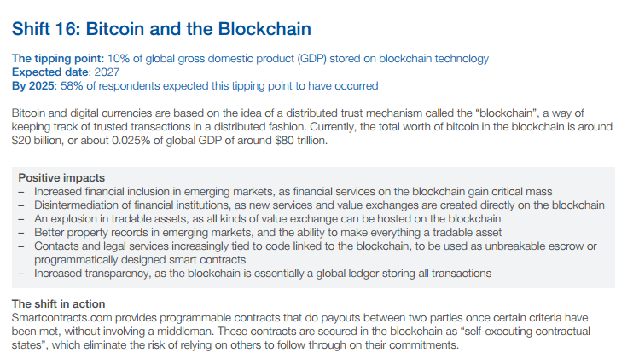
Global Agenda Council on the Future of Software & Society
http://www3.weforum.org/docs/WEF_GAC15_Technological_Tipping_Points_report_2015.pdf#page=24

Slide 16
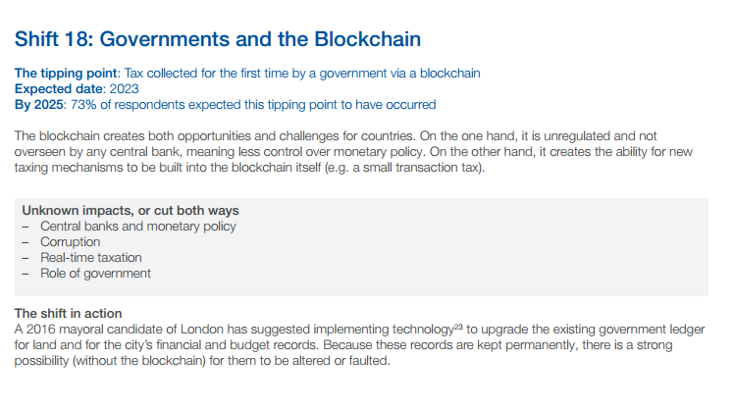
Global Agenda Council on the Future of Software & Society http://www3.weforum.org/docs/WEF_GAC15_Technological_Tipping_Points_report_2015.pdf#page=24

Slide 17
THE INTERNET OF THINGS – AI IN SMART CONTARCTS
What if AI was injected into a smart contract?
This would mean that the model would have the ability to ‘think’ and include decision making processes in the execution of the contract.
Is it possible to code ethics into AI, however?

Slide 18
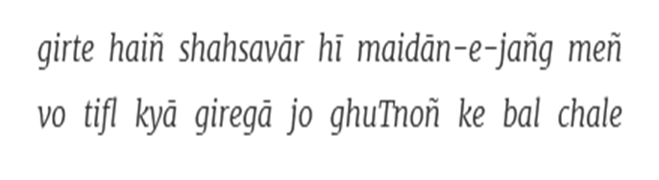
Conclusion

Slide 19
Open for Questions

